Slide 1
Chapter 11
Introducing .NET Assemblies

Slide 2
Objectives
Examining the core details of creating, deploying, and configuring .NET assemblies
Understanding the distinction between
  single-file and multifile assemblies
  "private" and "shared" assemblies
The Global Assembly Cache (GAC)
Application configuration files (*.config files)

Slide 3
Content
The role of .NET Assemblies
Understanding the format of a .NET Assembly
Single-File and Multifile Assemblies
Private and Shared Assemblies.
Understanding configuration files

Slide 4
The role of .NET Assemblies
Assemblies promote code reuse
  Code library
    contains types intended to be used by external applications
    need not take a *.dll file extension
  Allows to reuse types in a language-independent manner
    It is possible to not only allocate types across languages, but derive from them as well.

Slide 5
The role of .NET Assemblies
Assemblies establish a type boundary
  A type's fully qualified name is composed by prefixing the type's namespace to its name
  The assembly in which a type resides further establishes a type’s identity.
Assemblies are versionable units
  .NET assemblies are assigned a four-part numerical version number of the form <major>.<minor>.<build>.<revision>
  Allows multiple versions of the same assembly to coexist in harmony on a single machine.

Slide 6
The role of .NET Assemblies
Assemblies are self-describing
  Assemblies are regarded as self-describing in part because they record every external assembly it must have access to in order to function correctly
  Assembly’s manifest is a blob of metadata that describes the assembly itself
  An assembly contains metadata that describes the composition of every contained type.

Slide 7
The role of .NET Assemblies
Assemblies are configurable
  Assemblies can be deployed as “private” or “shared.”
  Private assemblies reside in the same directory (or possibly a subdirectory) as the client application making use of them.
  Shared assemblies are libraries
    intended to be consumed by numerous applications on a single machine
    are deployed to a specific directory termed the Global Assembly Cache (GAC).
  XML-based configuration files.

Slide 8
Understanding the format of a .NET Assembly
A .NET assembly (*.dll or *.exe) consists of the following elements:
  A Win32 file header
  A CLR file header
  CIL code
  Type metadata
  An assembly manifest
  Optional embedded resources

Slide 9
Understanding the format of a .NET Assembly
The Win32 File Header
  establishes the fact that the assembly can be loaded and manipulated by the Windows OS
  identifies the kind of application (console-based, GUI-based, or *.dll code library)
  Example: dumpbin /headers CarLibrary.dll

Slide 10
Understanding the format of a .NET Assembly
The CLR File Header
  defines numerous flags that enable the runtime to understand the layout of the managed file
  Example: dumpbin /clrheader CarLibrary.dll

Slide 11
Understanding the format of a .NET Assembly
CIL Code,Type Metadata, and the Assembly Manifest
Optional assembly resources
  a .NET assembly may contain any number of embedded resources such as application icons, image files, sound clips, or string tables.
  be useful if you wish to partition your resources based on a specific culture (English, German, etc.)

Slide 12
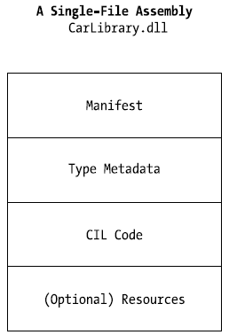
Single-file and Multifile Assemblies
Single-File Assemblies
  one-to-one correspondence between the (logical) assembly and the underlying (physical) binary

Slide 13
Single-file and Multifile Assemblies
Multifile Assemblies
  A set of .NET *.dlls that are deployed and versioned as a single logic unit
  Primary module contains the assembly-level manifest (as well as any necessary CIL code, metadata, header information, and optional resources)
  The secondary modules
    take a *.netmodule file extension
    contain CIL code and type metadata, as well as a module-level manifest

Slide 14
Single-file and Multifile Assemblies
Benefits of Multifile assemblies
  provide a very efficient way to download content
  enable modules to be authored using multiple .NET programming languages
Notes:
csc.exe /t:module ufo.cs => ufo.netmodule
csc /t:library /addmodule:ufo.netmodule /out:airvehicles.dll helicopter.cs
At this point, your directory should contain the primary airvehicles.dll module as well as the
secondary ufo.netmodule binaries.

Slide 15
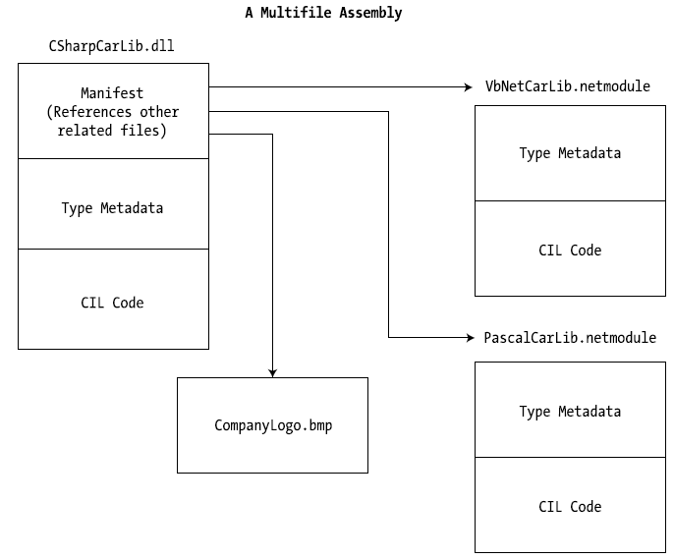

Slide 16
Private and Shared Assemblies
Private assemblies are required to be located within the same directory as the client application (termed the application directory) or a subdirectory thereof.
The full identity of a private assembly consists of the friendly name and numerical version
The friendly name simply is the name of the module that contains the assembly's manifest minus the file extension
The CLR does not use of the version number when resolving its location
For a single machine may have multiple copies of the same private assembly in various application directories

Slide 17
Private and Shared Assemblies
A shared assembly is a collection of types and (optional) resources.
Difference between shared and private assemblies is a single copy of a shared assembly can be used by several applications on a single machine.
Shared assemblies are installed into the Global Assembly Cache (GAC) - C:\Windows\Assembly
Executable assemblies (*.exe) can not be installed into the GAC.
An assembly must be assigned a strong name before being deployed to GAC

Slide 18
Private and Shared Assemblies
Understanding strong names
  is used to uniquely identify the publisher of a given .NET binary
  are based on two cryptographically related keys (termed the public key and the private key)
  is composed of a set of related data
    Friendly name
    Version number
    Public key value
    An optional culture identity value for localization purposes
    An embedded digital signature

Slide 19
Understanding configuration files
Application configuration files
  Use of XML elements that are read by the CLR to resolve the location of external assemblies
  Contain application-specific data
  The System.Configuration namespace provides some types to read custom data from a client's *.config file
Notes:
<configuration>
<runtime>
<assemblyBinding xmlns="urn:schemas-microsoft-com:asm.v1">
<probing privatePath="MyLibraries"/>
</assemblyBinding>
</runtime>
</configuration>

Slide 20
Understanding configuration files
The Machine Configuration File
  Contain a vast number of configuration details that control how the .NET platform operates.
  The is a separate *.config file for each version of the .NET framework.
  Be careful when edit the machine configuration file.

Slide 21
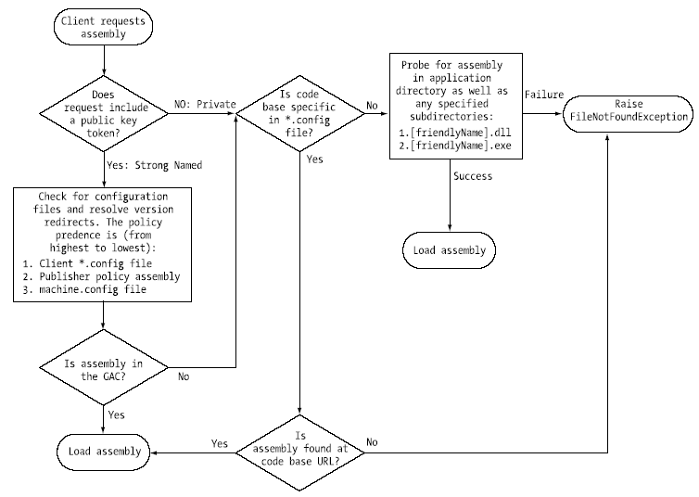
The Assembly Binding “Big Picture”
Notes:
<configuration>
<runtime>
<assemblyBinding xmlns="urn:schemas-microsoft-com:asm.v1">
<dependentAssembly>
<assemblyIdentity name=" CarLibrary" publicKeyToken="219ef380c9348a38" />
<codeBase version="2.0.0.0" href="file:///C:\MyAsms\CarLibrary.dll" />
</dependentAssembly>
</assemblyBinding>
</runtime>
</configuration>

Slide 22
Q & A

